Slide 1
DEVICE TO EASE THE FINDING OF PEOPLE TRAPPED IN BUILDING COLLAPSE
Disaster Management using IoT
By
191EC184-KarunRaj R K S
191EC202-Manojkumar M
191EC199-Manoj S
191EC198-Mithunkumar M

Slide 2
Device To Ease The Finding Of people Trapped In Building Collapse
Introduction
During Disasters like Earthquake, Landfall, etc… The Buildings start to crack and sometimes it collapse suddenly. This leads to death and injury of people inside and very close to them. But, some get trapped in between the blocks and slowly losing their lives. It is a very difficult process to rescue them. Our project will make this kind of rescue faster and easier.

Slide 3
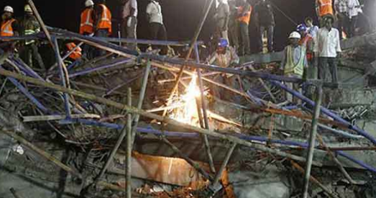
Block Diagram
*
Monitor
Connected to wireless
Mini remote controlled vehicle contains sensors cameras and components
Alerts and highlight the particular spot in the monitor if any person is found in the camera or sensors range
Sending it into the heavy, hard to move and complicated narrow paths inside building collapse
Sensors and camera shows around narrow fallen blocks

Slide 4
Sensors and Components
Thermal Camera
Sound sensor
Video camera
And a touch screen monitor connected to a small six wheeled vehicle like crawler which is fixed and interconnected with the above three and other important components.

Slide 5
Components Price
Thermal camera - 1500
Sound sensors - 700
Video Camera - 1100
Remote controlled 6 wheeler - 1200
Monitor - 1500
Other Hardware components - 1000
Total 7000

Slide 6
Plan
By using Thermal detection, sound detection combined with risky narrow path travelling system. We will find the trapped people more efficiently. The device look similar to a remote car sized bot. It is connected with lights, camera, thermal and sound sensors connected to a display through a long wire for us to monitor and operate it from a distance.

Slide 7
Execution
By sending it into the narrow complex blocks, which is very difficult and take lot of time for us to enter. We will find the trapped person by body heat, voice and also through camera vision. By this we can make this building collapse rescue faster and efficient and by this we can save more number people.

Slide 8
Thank you

